Slide 1
Improving Standard Transformer Models for 3D Point Cloud Understanding with Image Pretraining
Notes:
adersfbtngdy

Slide 2
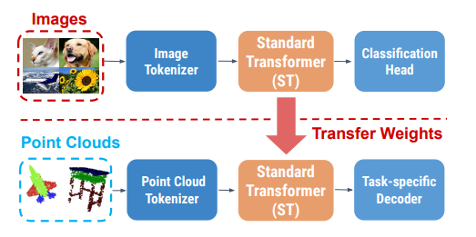

Slide 3
Key ideas
Modify the tokenizer, progressively project input point clouds into tokens
Append global representations in the decoder, such as the maxpooled tokens

Slide 4
PViT Network

Slide 5

Tokenizer t: Progressive Point Patch Embedding.

Slide 6
Decoder g: Feature Propagation with Global Representation Appending.
output of the global representation appending for every point xi i
segmentation
classification

Slide 7

Pix4Point
Pretraining Stage
Weight Transfer Stage
Finetuning Stage

Slide 8
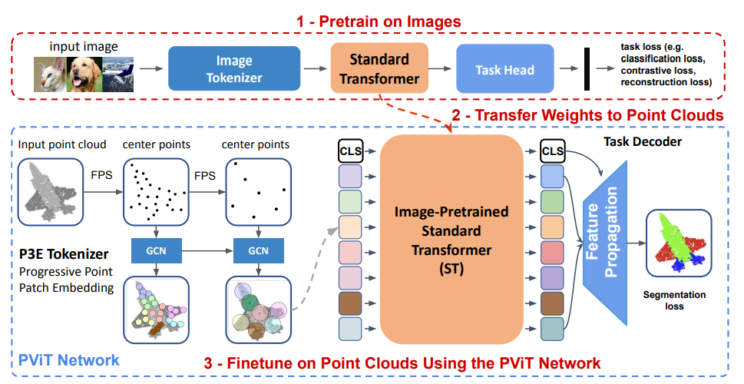
Notes:
3rztxhcjm,kb.l

Slide 9
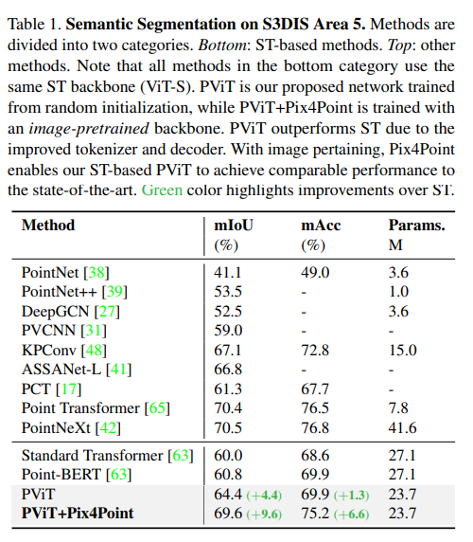

Slide 10
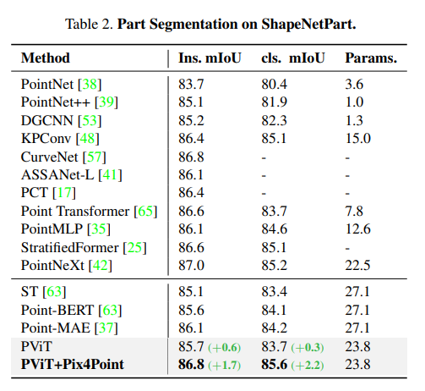
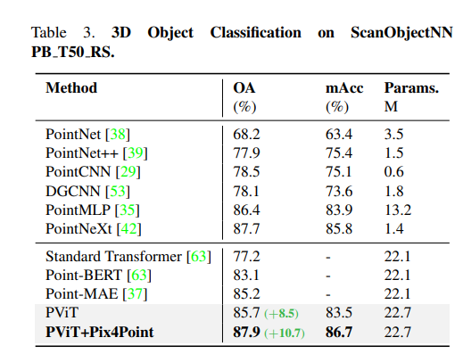

Slide 11
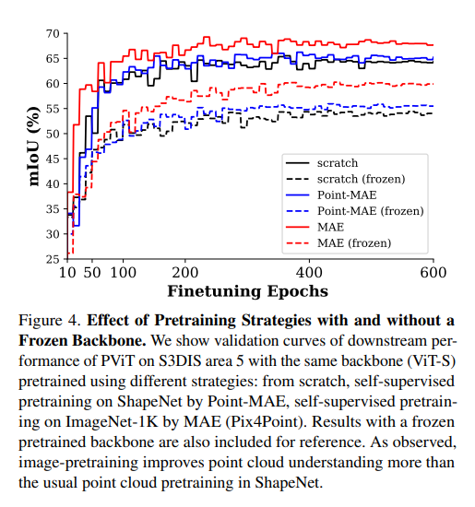
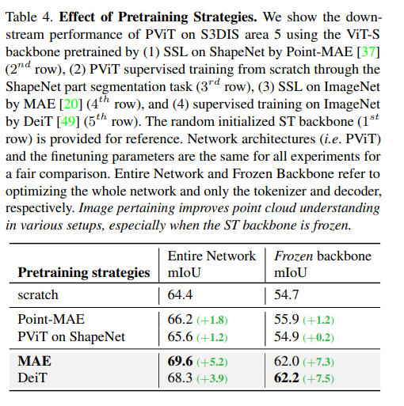

Slide 12
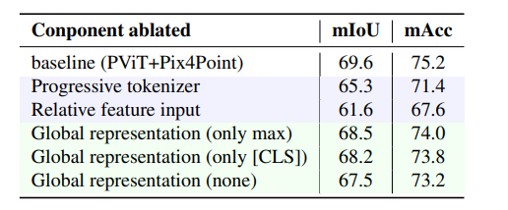
Ablation Study of the PViT Architecture

Slide 13
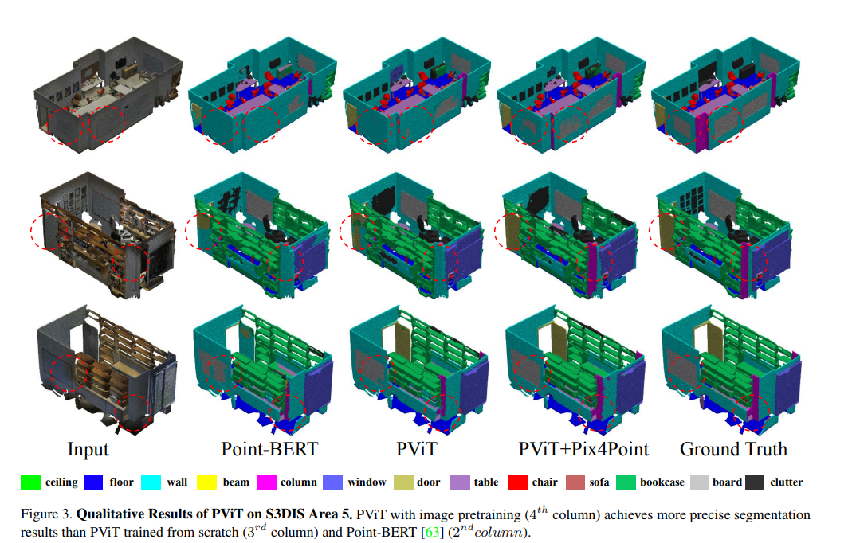

Slide 14


